Slide 1

Day 1, part 2 - coding
ITG DATAHUB ST
Paris, September 23rd, 2019

Slide 2
Agenda
1
Coding environment
Code recipes
Notebooks in DSS
Code environment
Variables in DSS
2
The Dataiku api
Reading and writing Datasets
Working with folders
3
Hands on

Slide 3
Coding environment
1

Slide 4
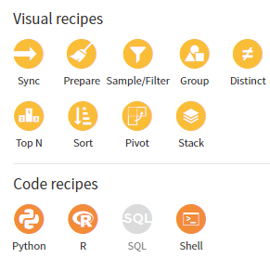
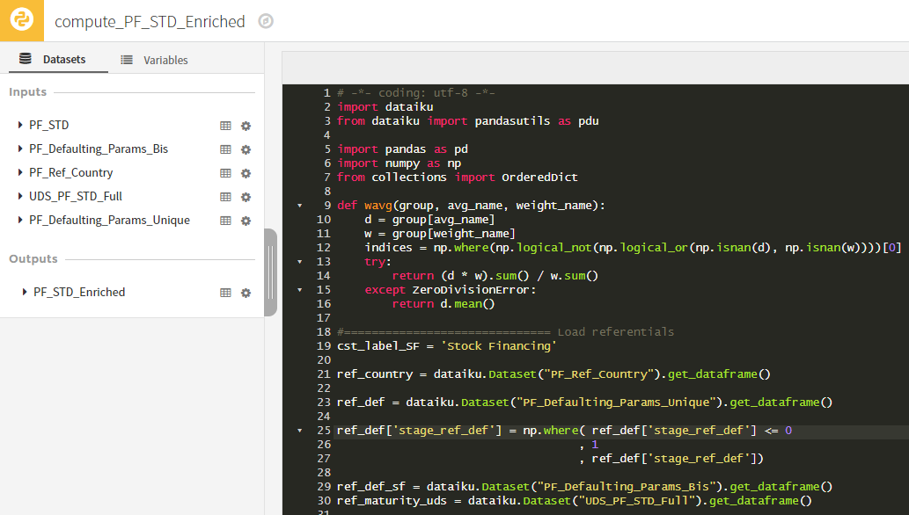
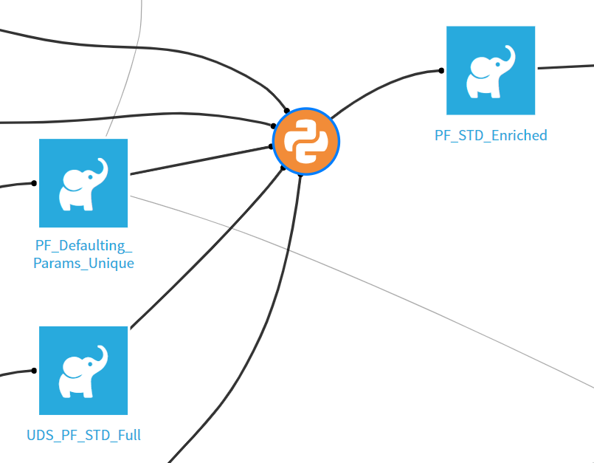
Code recipes
The visual recipes allows you to prepare your data most of the time in a quick and efficient way.
For more advanced manipulations (using extra librairies, preparing your data in a way that is not doable in visual recipes…), you can code your own transformation.
Available code recipes are Python, R, SQL and Shell

Slide 5
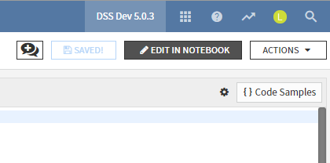
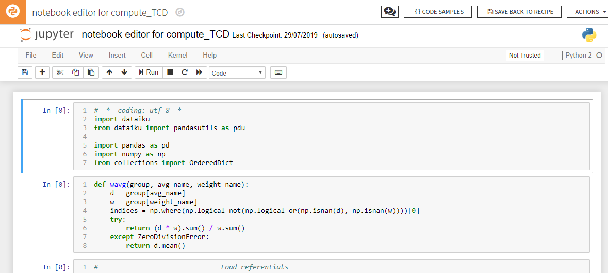

Notebooks in Dataiku
Debugging code in the recipe is not easy. Using a notebook is considered a best practice.
Recipes
Production code
Project flow management
Reusable across projects
Notebooks
Interactive code design and debugging
Charts and reports

Slide 6
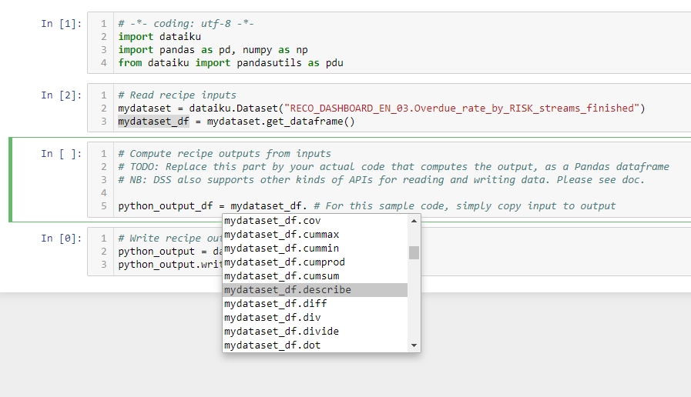
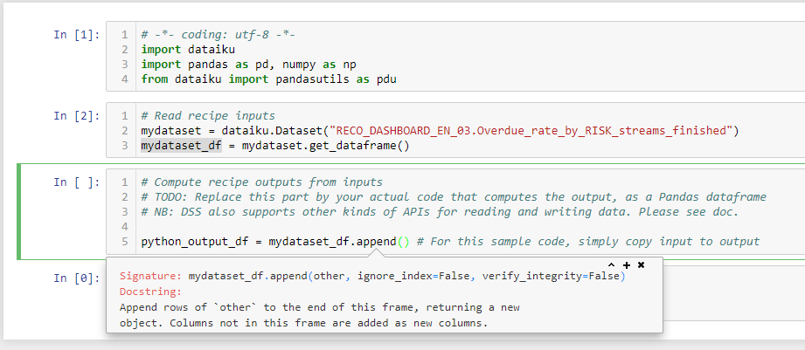
Notebooks in Dataiku : tips
Code execution
Shift + Enter to execute a cell
Alt + Enter to execute a cell and create a new one
Documentation
Hit Tab on an object to see available attributes / functions
Hit Shift + Tab inside a function to see the documentation
→ Enable this with your own functions using PEP styling guide

Slide 7
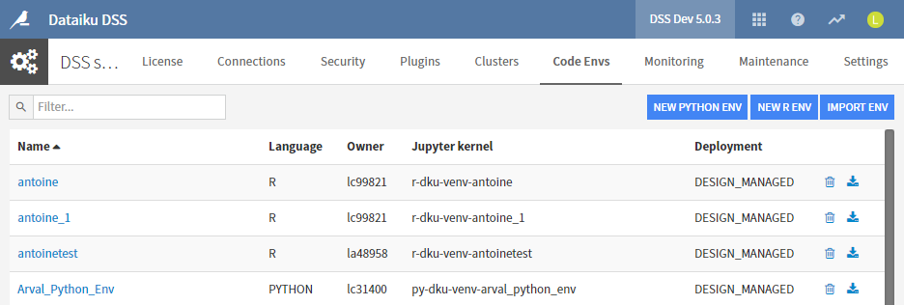
Code environment
DSS allows for users to manage their own Python / R code environments.
Ask for your own to the MLIST !
These envs can be activated and deactivated for different DSS objects :
Project wide
Web apps, notebooks, code recipe…

Slide 8
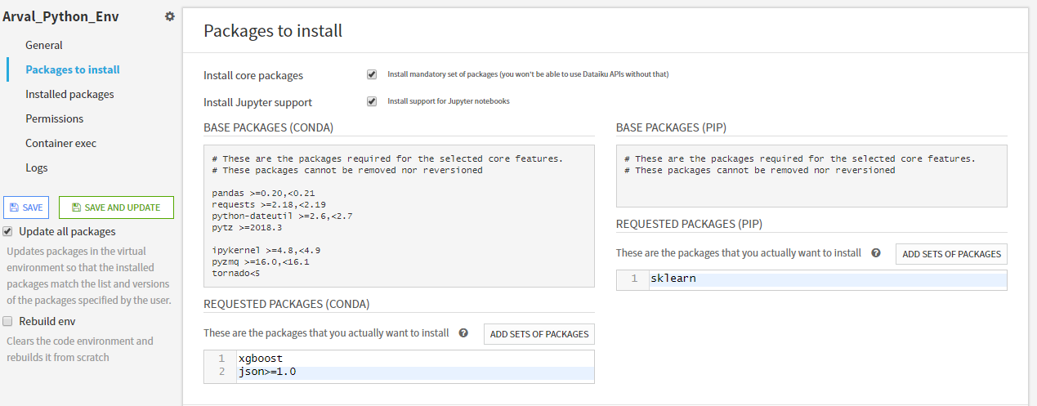
Code environment
To install new packages :
→ Administration → Code Envs
Click on your Env in the list
Type in the packages you wish to install line by line (as in a requirements.txt)
Click "SAVE AN UPDATE"

Slide 9
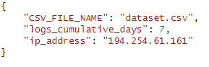
Variables in DSS
Variables can be created at instance or project level
They can be accessed :
In any notebook / recipe / scenario / etc.
Directly in configuration fields (dateaset settings, etc.)
By multiple users
Set up with json syntax (dictionary format, double quotes for keys and strings)

Slide 10
The Dataiku API
2

Slide 11
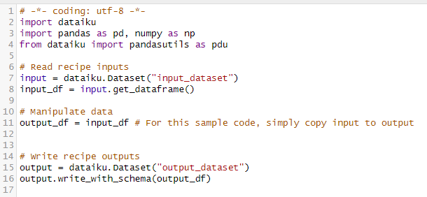
Reading and writing Datasets
1
2
3
4
5
6
Import the dataiku package
Declare a Dataiku dataset object for the input dataset
Load the dataset content in memory (as a pandas)
Manipulate the dataset with every python library available
Declare a Dataiku dataset object for the output dataset
Write the pandas dataframe in the output dataset

Slide 12



Reading and writing Datasets
What if my input dataset does not fit in memory ?
Read a sample
Use a streaming strategy
Read by dataframe chunks

Slide 13
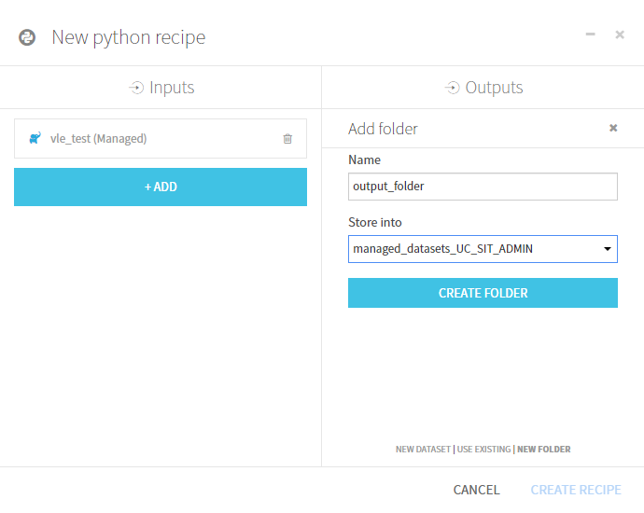
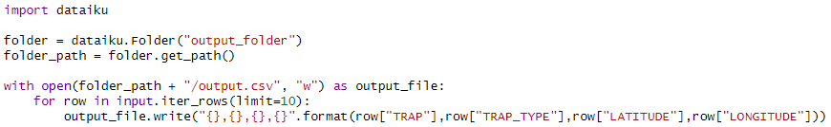
Working with Folders
Sometimes, Datasets are not enough (storing images, generating special file formats…)
Create a folder
Get the folder path
Interact with it how you would with a regular directory path

Slide 14
HANDS on !
3

Slide 15
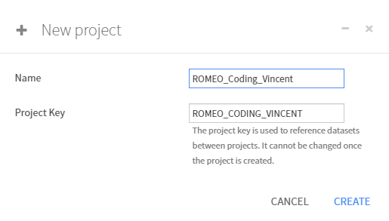
Create a project
Create a project. As you will all use the same space, please add your name to it.
ROMEO_Coding_Vincent

Slide 16
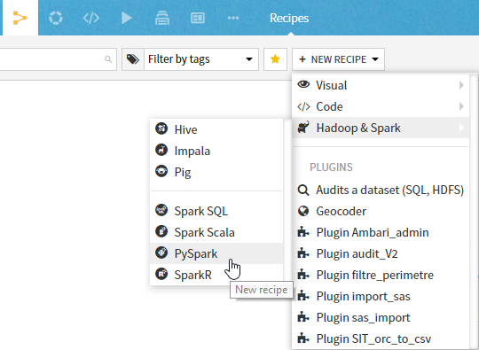
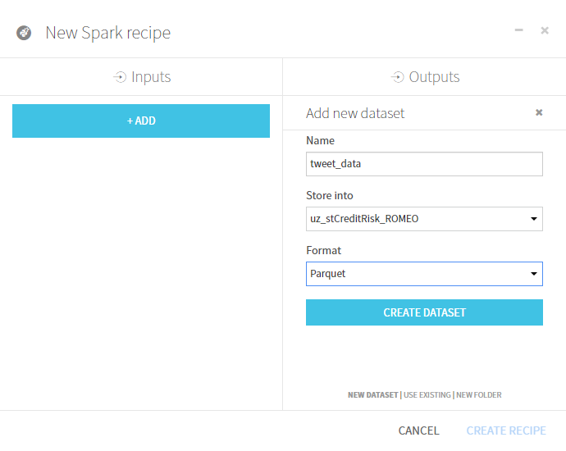
First code recipe (1/3)
Use a pySpark recipe to import the data from the Hive table tweet_data_hive in the database uz_stCreditRisk_ROMEO in a dataset called tweet_data

Slide 17
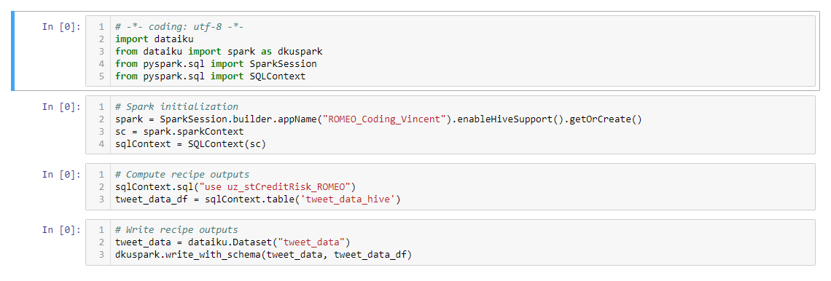
First code recipe (2/3)
Edit in a notebook for ease of use, try to run the code, and when it works, save it back to the recipe.
Tip : you can split a cell under the cursor with the menu Edit > Split Cell

Slide 18
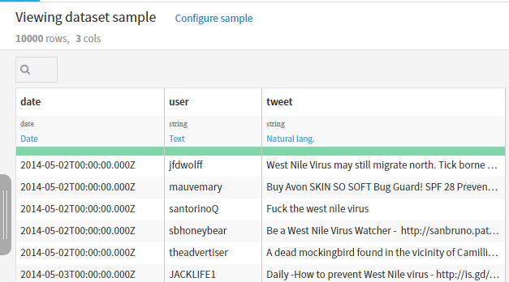
First code recipe (3/3)
Run the recipe and explore the created dataset.

Slide 19
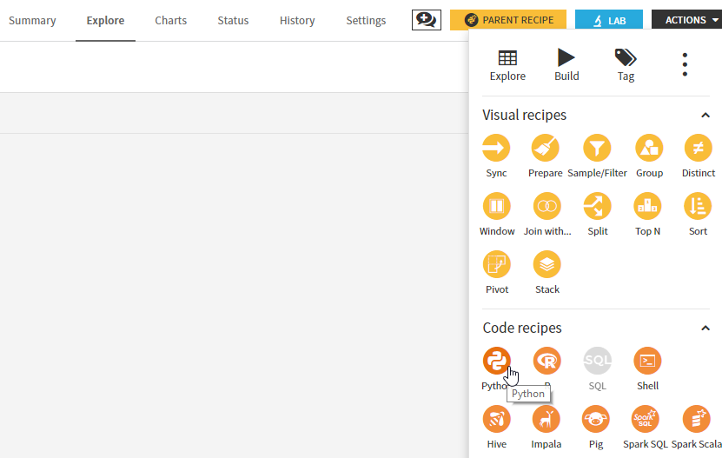
Manipulating data with python
Create a python recipe from the created dataset, with the output dataset called tweet_data_mention.

Slide 20
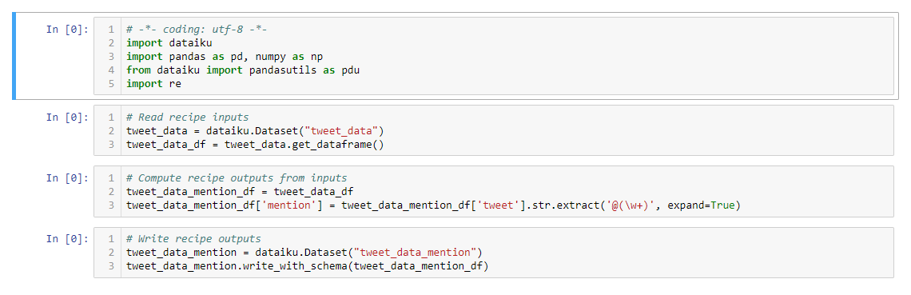
Manipulating data with python (1/2)
Extract the mention from the tweet, and save it to a new column named mention.

Slide 21
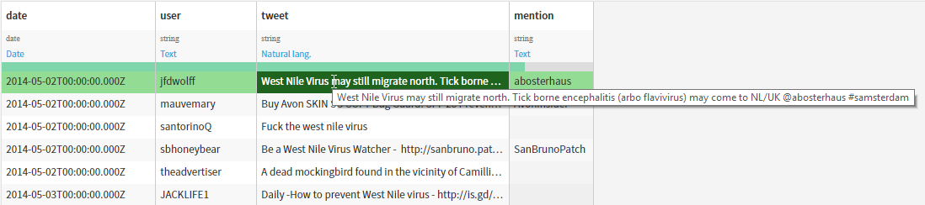
Manipulating data with python (2/2)
Run the recipe, explore the created dataset, and confirm that the mention was extracted.

Slide 22
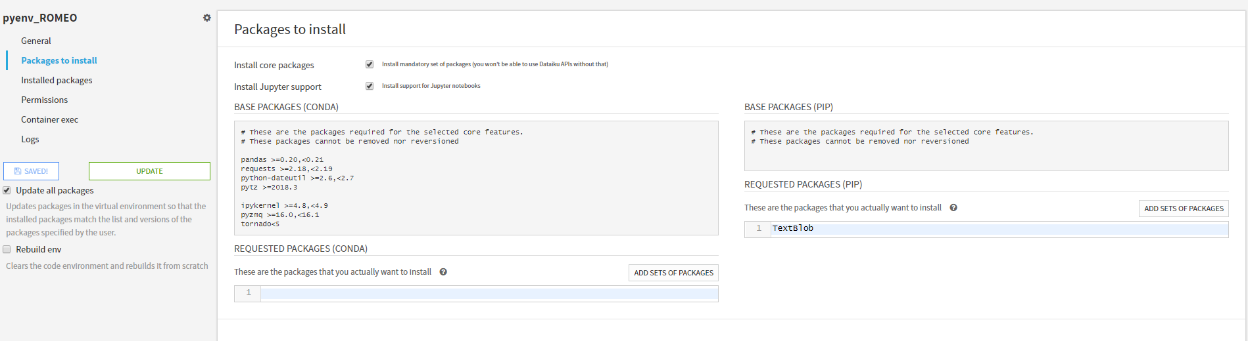
Code envs (1/4)
We are now going to extract the sentiment from the tweet (is it a positive tweet or a negative tweet ?). To do so, we are going to use the library TextBlob, which is not available by default.
Go to the code env settings, find the one called pyenv_ROMEO, and check that it has the new library.

Slide 23
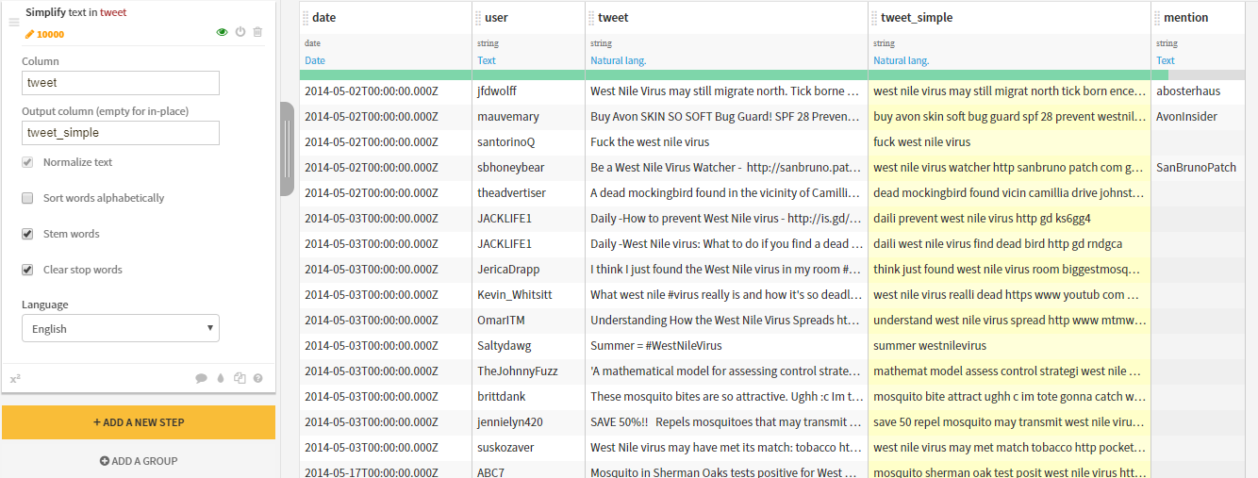
Code envs (2/4)
First, we are going to need to simplify the tweet (stem words, clear stop words). For this, we are going to use a visual prepare recipe with a Simplify step, and output a tweet_data_mention_prepared dataset.

Slide 24
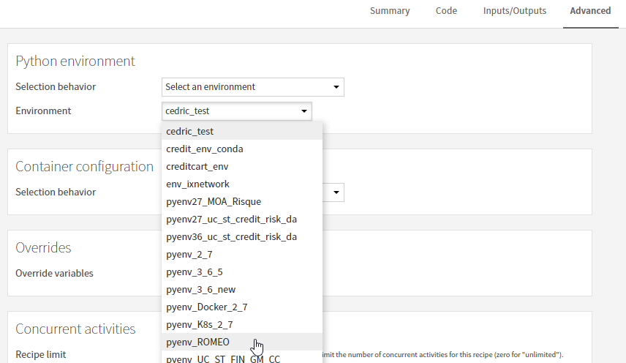
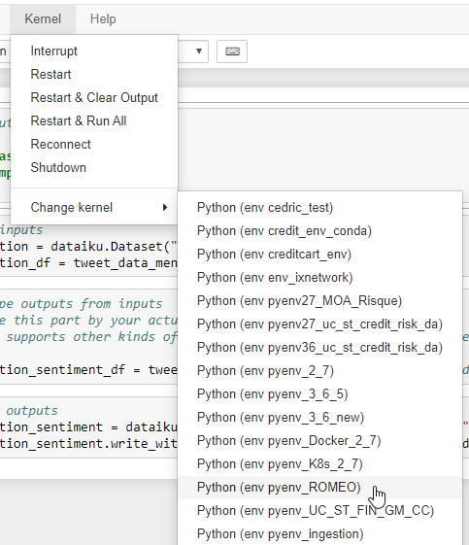
Code envs (3/4)
Go back to the flow, and create a python recipe to extract the sentiment, with tweet_data_mention_prepared as input and tweet_data_mention_sentiment as output.
Be sure to use the right code env, in the recipe or in the notebook.

Slide 25
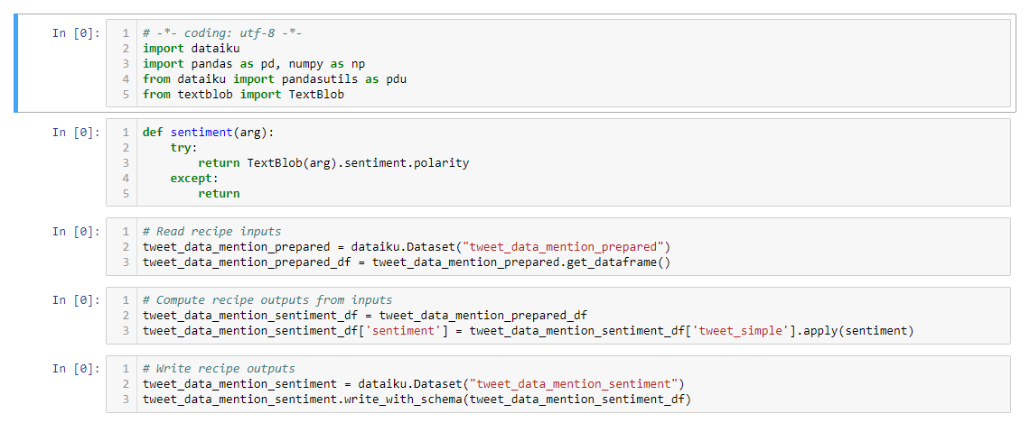
Code envs (4/4)
Save back to the recipe, run the recipe, and explore the dataset.

Slide 26
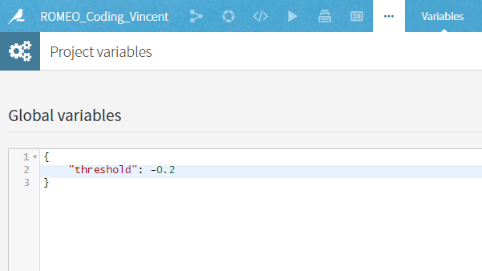
Variables and folders (1/4)
We are now going to extract the tweets beneath a threshold. To be able to modify the threshold without modifying the recipe, we are going to set a variable at the project level.

Slide 27
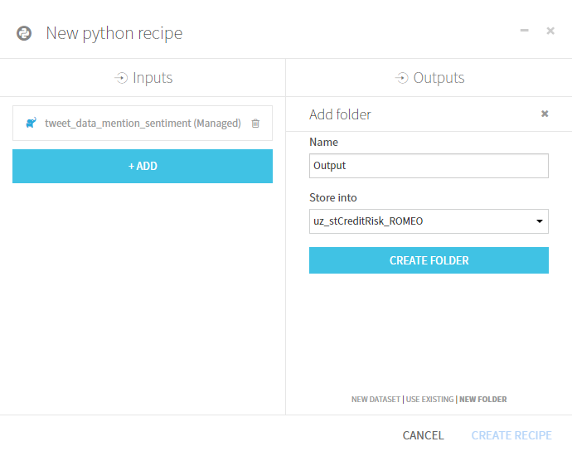
Variables and folders (2/4)
We are going to build the output file in a folder. On the creation of the Python recipe, change the output to be a folder, called Output.

Slide 28
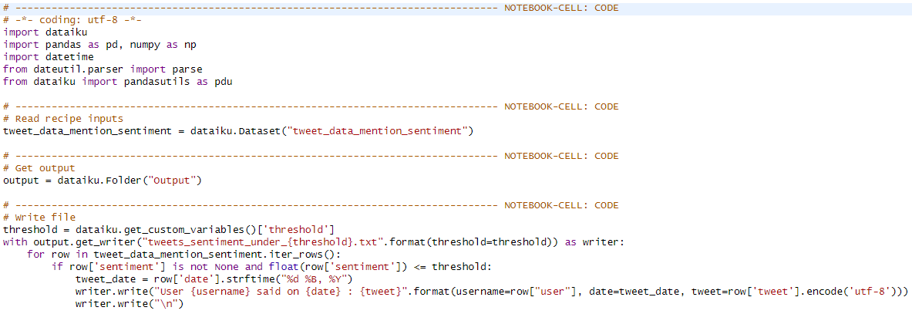
Variables and folders (3/4)
Use a streaming strategy to test the sentiment on each line, and write it to a file if valid.

Slide 29
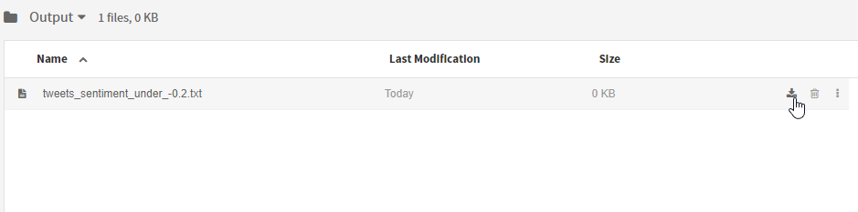
Variables and folders (4/4)
Run the recipe. You can now download the generated file

